Slide 1
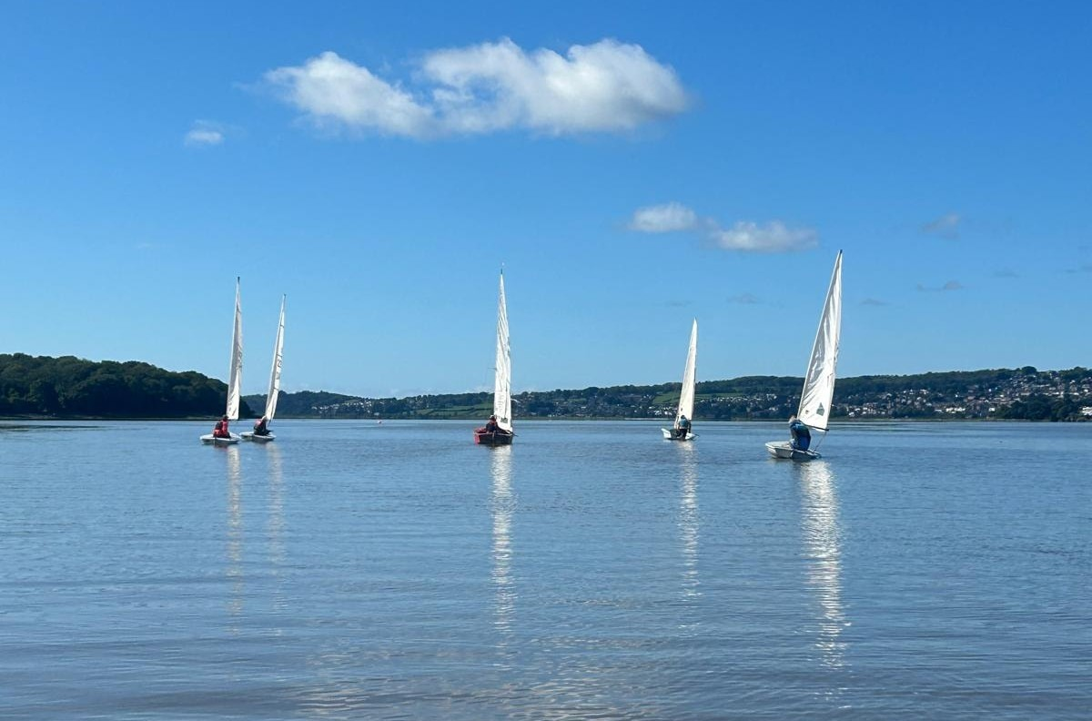
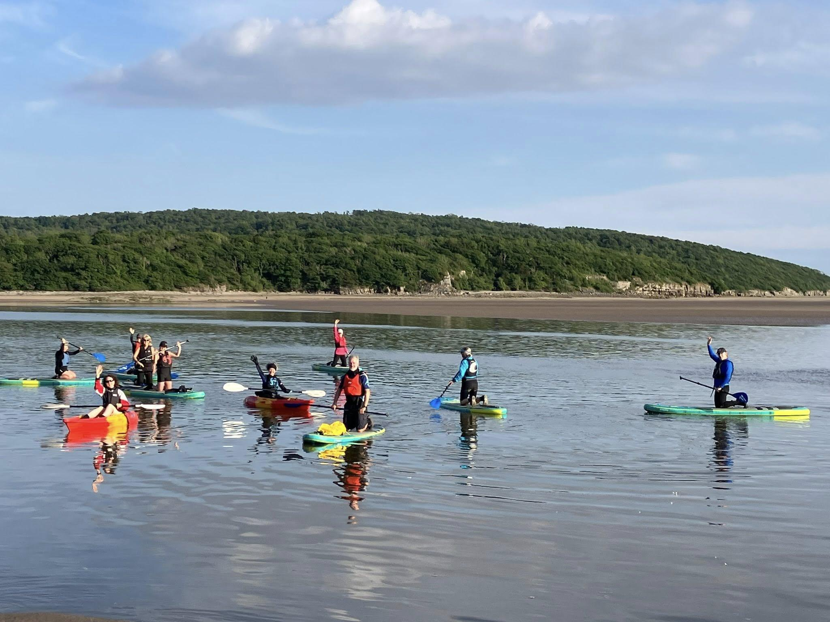






Strategy Meeting 30 Nov 25
1. Adult Sailing
2. Paddle Sports
3. Youth
4. Schools
5. Volunteering
5. Fees, Committee for next year, AGM

Slide 2
Membership
Sailing | Number | % | Approx Income
Adult Arnside | 37 | 31% | £3670
Adult Killington | 8 | 7% | £830
Youth Parents | 21 | 18% | £2130
Training | 7 | 6% | £710
Total | 73 | 62% | £7340
Other
Paddle Boarding | 15 | 13% | £1540
Kayak | 7 | 6% | £710
Support Club | 10 | 9% | £1065
Social | 11 | 10% | £1185
2024 | 2025
123 | 116
2024 | 2025
£11960 | £11845
2025
New members 25 (22%)
Leavers 29 (23%)
2026?
Memberships 110
Income £11250

Slide 3
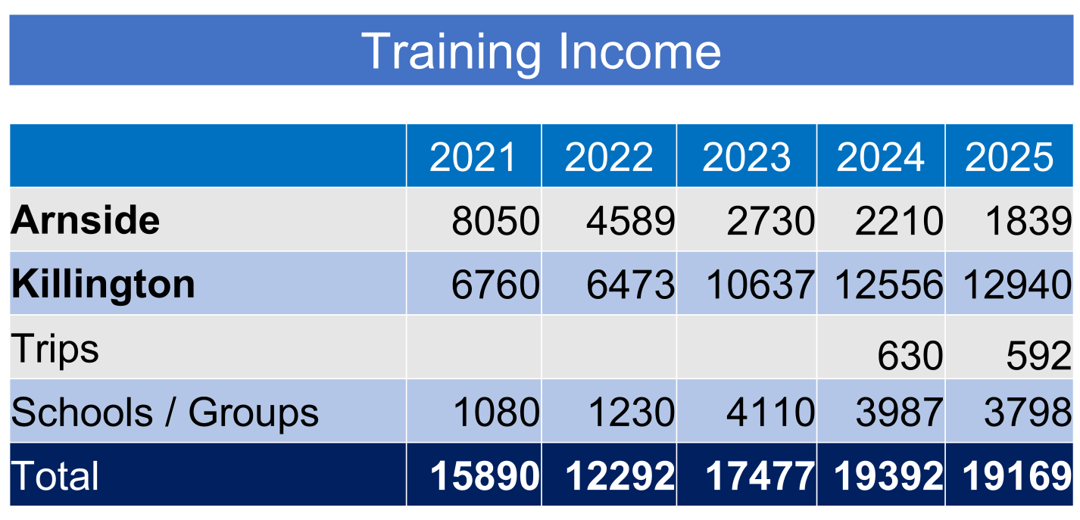
Increase Income
Increase no of school sessions
Increase prices for lessons at risk of fewer takers, less revenue
Reduce Costs
Reduce number of sessions that do not cover costs – risk of decline in membership income,
Reduce costs – Booking System,
Training Costs £22327 – includes subsided Club Nights, Youth Sessions and support for paddleboarding.
Training new members is also an investment in the future of the club
About £3000 of membership relates to training (reduced costs for club members, club nights and youth.

Slide 4
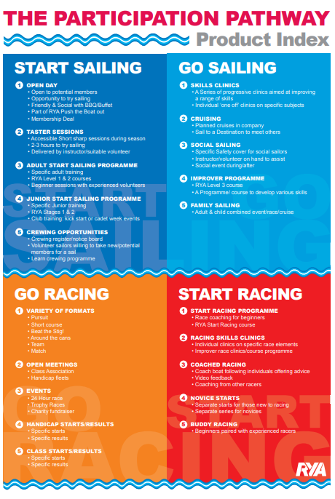
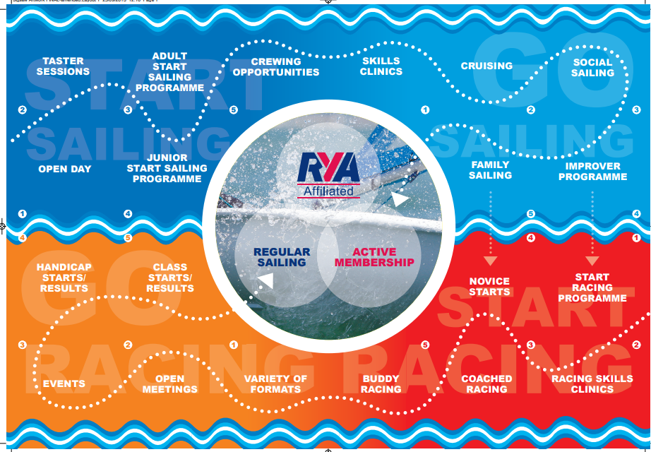
Adult Sailing

Slide 5
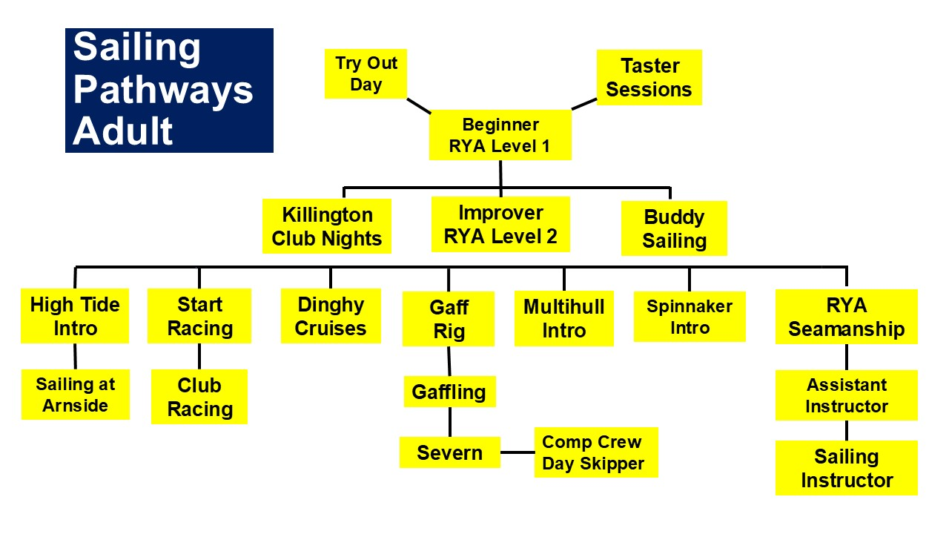

Slide 6
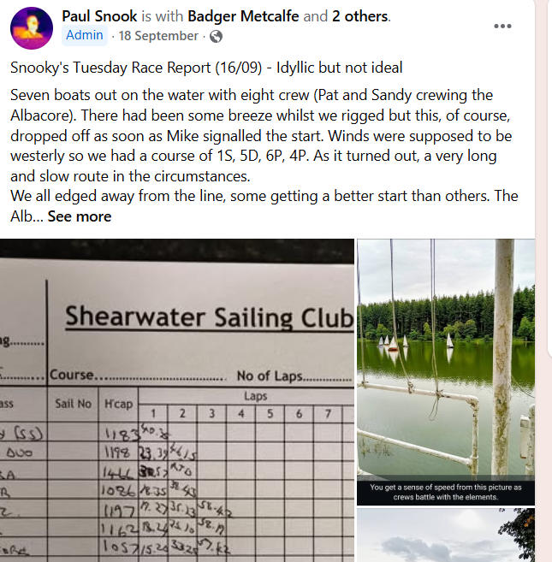
Reinvigorating Racing
Aims
Increase participation
Higher the standard
Run more races
Enter Teams in Open Events eg Southport
New Racers
Start Racing Session
Crewing opportunities
Beginner Early Start
Wanderer Open
Volunteer
Race Coaches
Racing Skills Sessions
Post Race
Socialising
Youth
Separate Youth Races / Coaching or
Take part in adult races
Publicise Results

Slide 7
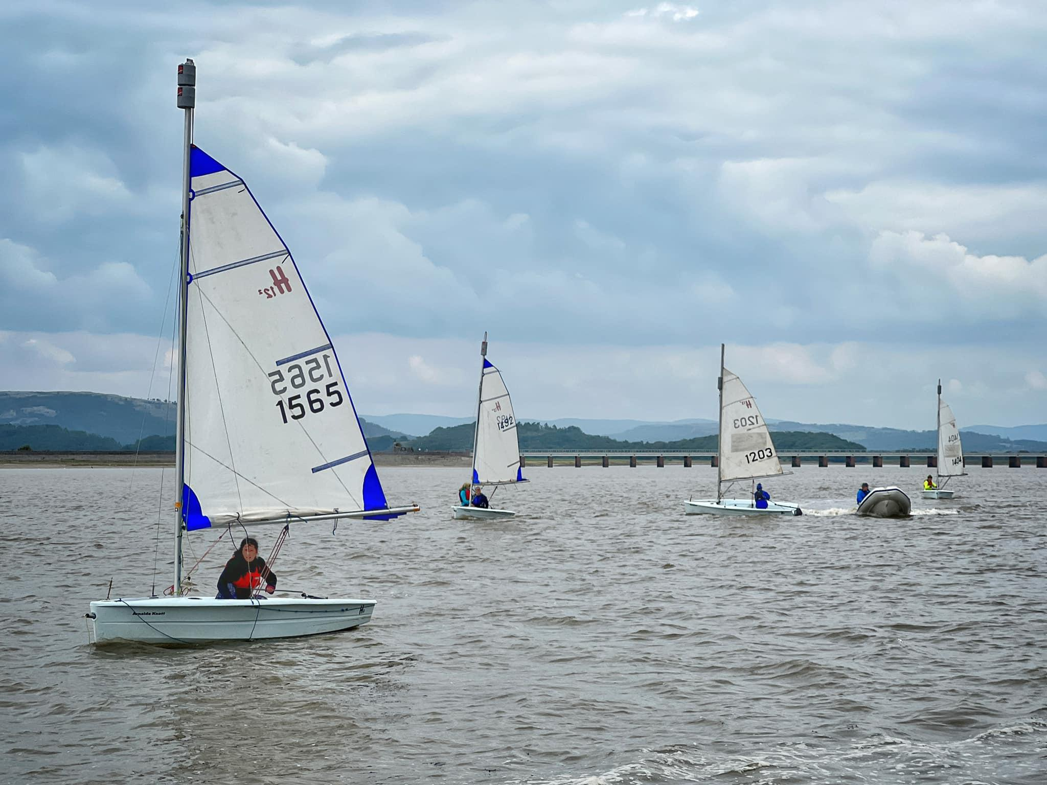
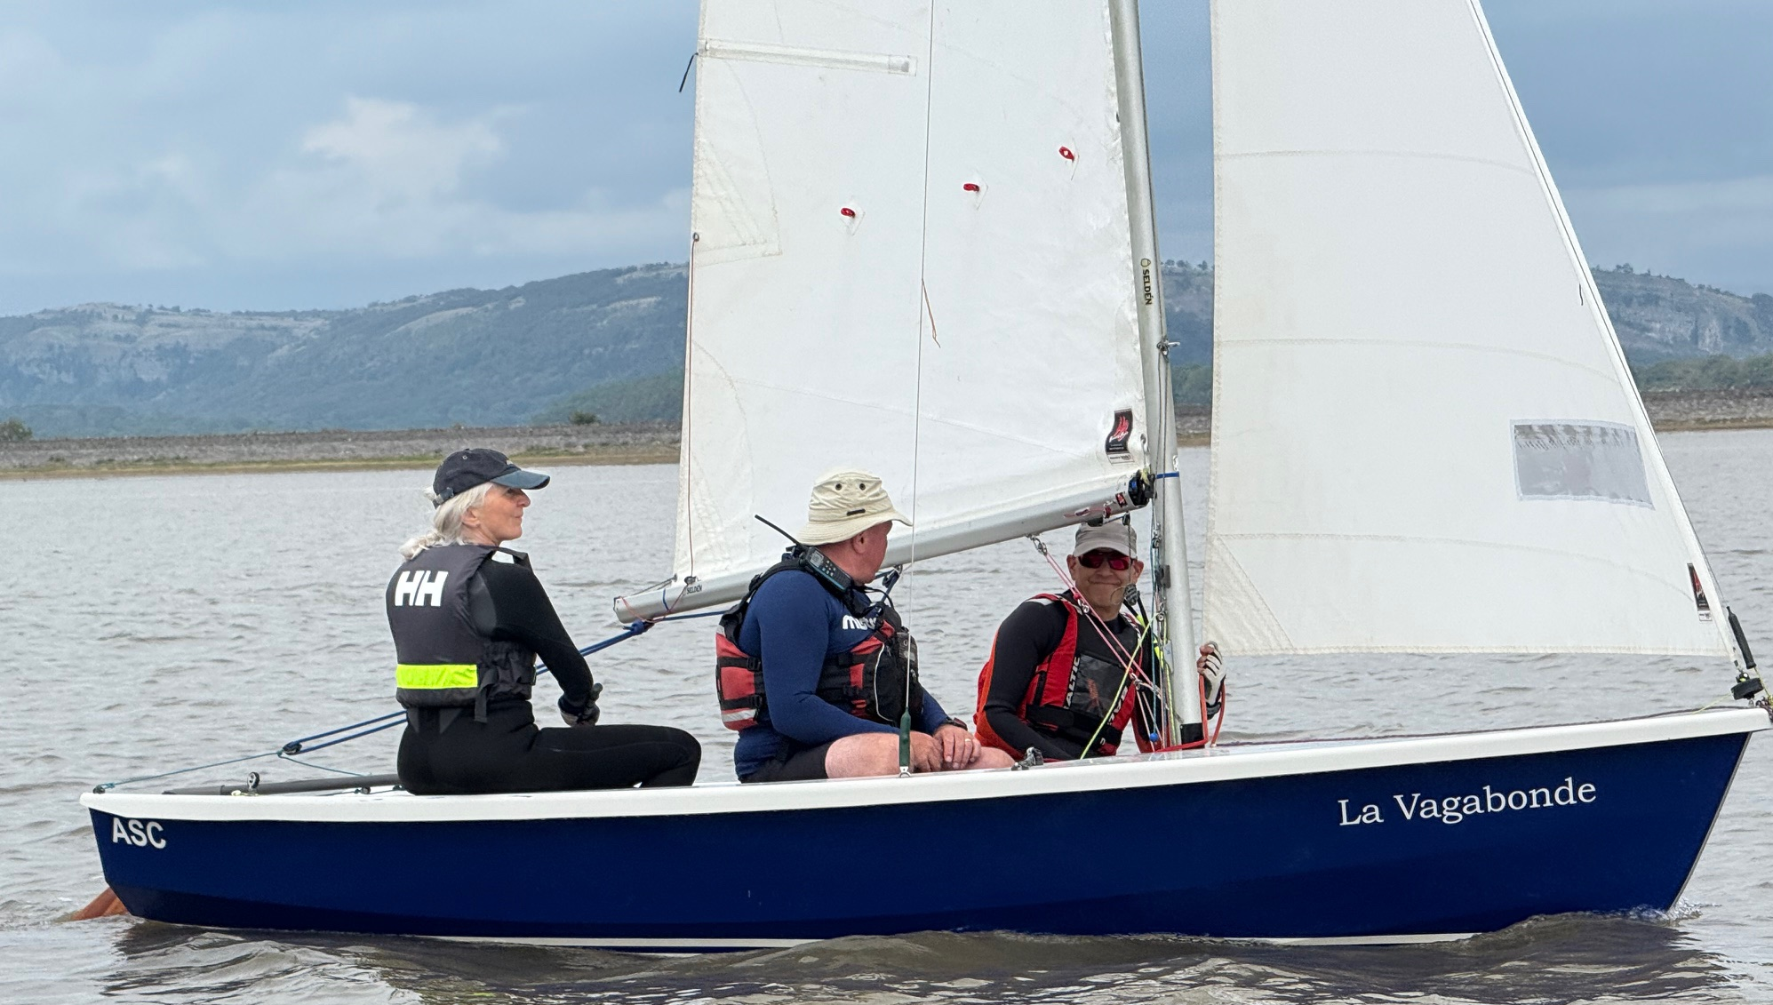
Introducing new sailors to sailing at Arnside
Sail with an experienced sailor
Social Sailing with safety boat cover
Learn to rig different boats sessions
High Tide with Instructor
(Single and doubled handed)
Having a boat where novice sailors can sail with an experienced sailor at most sessions

Slide 8
Adult Sailing
Social Sailing with
Safety Boat Cover
Arnside
Try Out Day
Taster Sessions
Killington
Improvers
Club Nights
Midweek Sailing
Dinghy Cruises out into Bay
Arnside
Instructor led sessions
Sail with an experienced
sailor
Racing
Arnside
Killington
Killington
RYA Beginner
Dinghy Cruises - Lakes
Severn
Advanced Skills

Slide 9
Resources
People
Paid Instructors
Volunteer Instructors
Assistant Instructors
Experienced Sailors
Safety Boat Volunteers
Shore Support
Event Organiser
Equipment
Club Craft
Killington Craft
Safety Boats
Buoyancy Aids etc
Training Needs
Volunteer Instructors
Race Coach
Safety Boat
First Aiders
Refresher Training
Volunteer Development
Maintenance
Replacement
Insurance
Financed by
Membership Fees
Training Fees
Donations
Grants
Fundraising
Promotion
Boat Park
Water Sports Hub
Launching Facilities

Slide 10
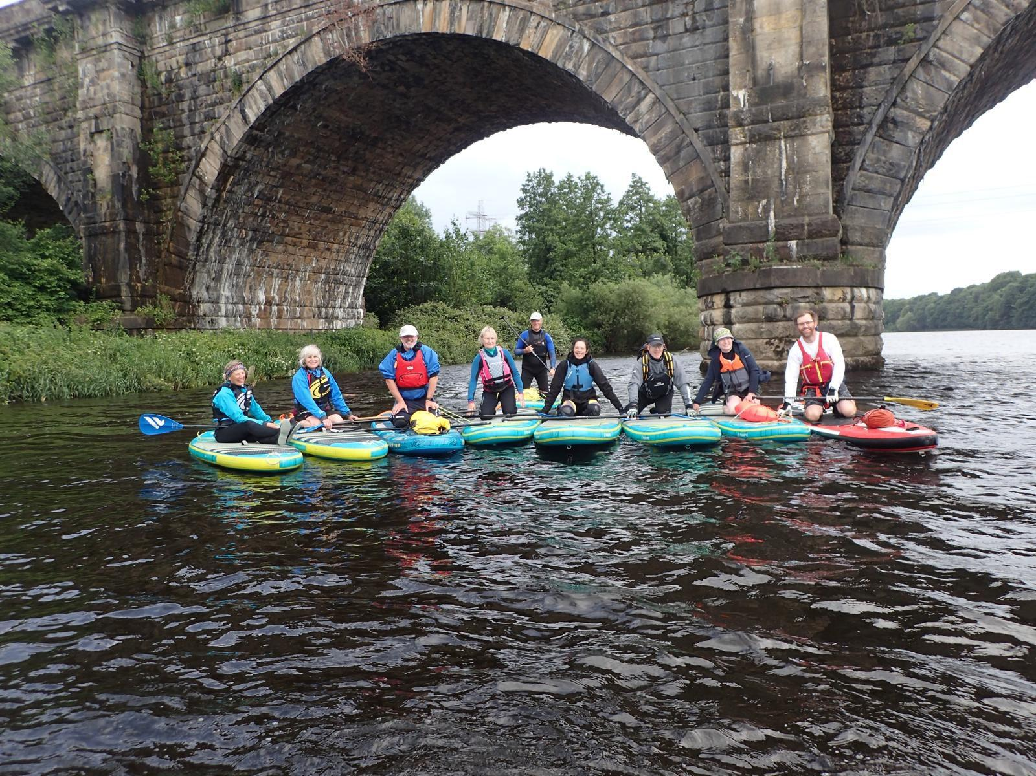
Paddle Sports
Programme
Beginner Lessons
Family Taster Sessions
(Guided Trips on Estuary)
Group Social Paddles Arnside
Group Social Paddles Killington
Informal Paddles – Arnside & K.Club Nights
Led Trips on Lakes, Rivers, Canals
Led Trips advanced - rapids
Extra Resources
Train 2 Volunteer SUP Instructors
2 Leader boards
Future Investment
Replacement Programme – Sups, Paddles
Instructor Training – Sheltered & Tidal Leaders

Slide 11
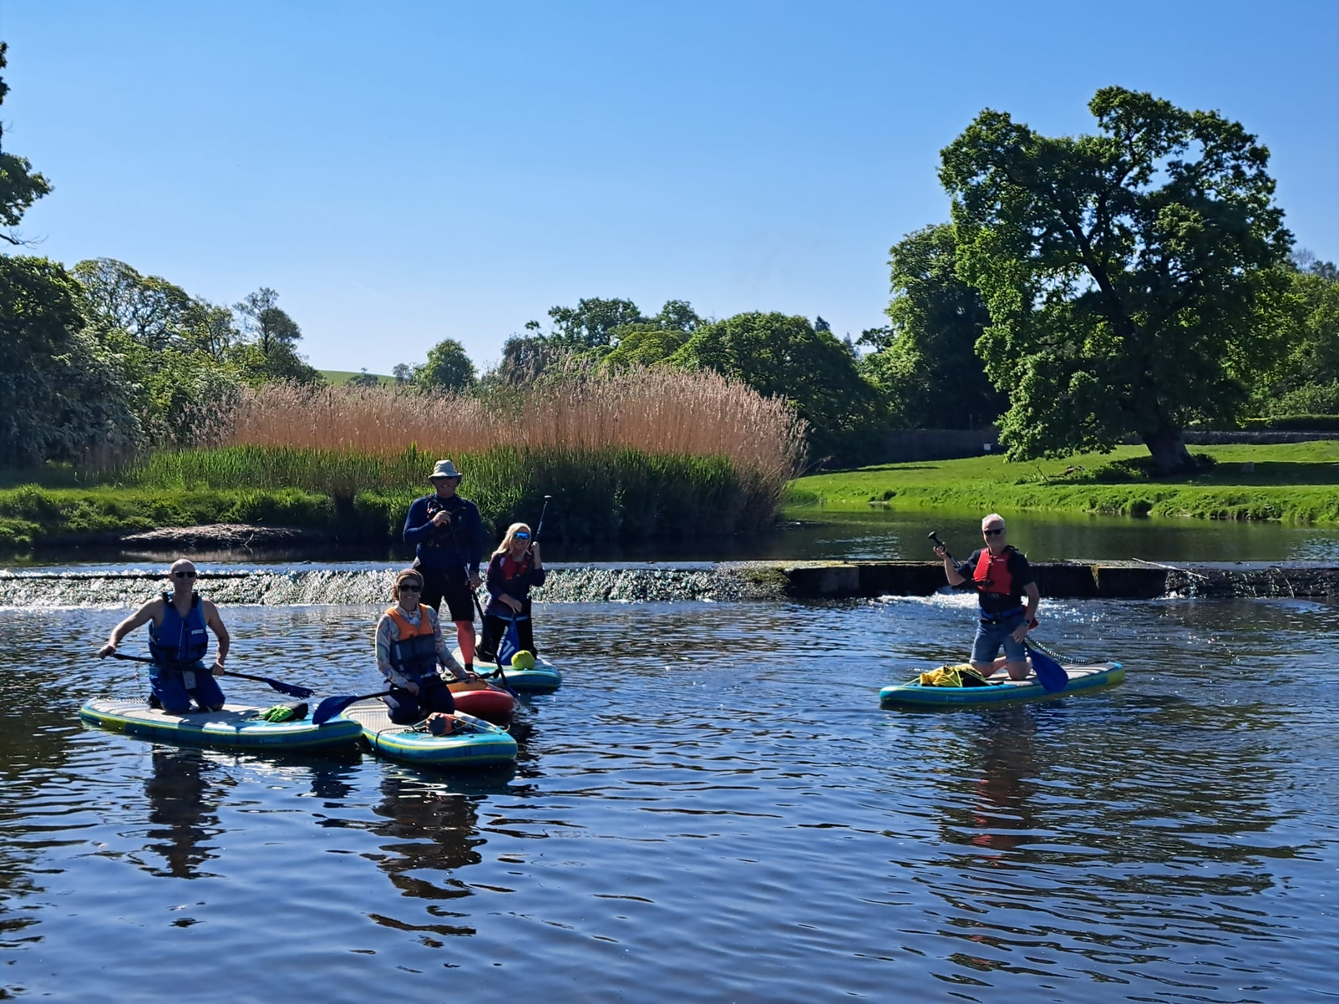
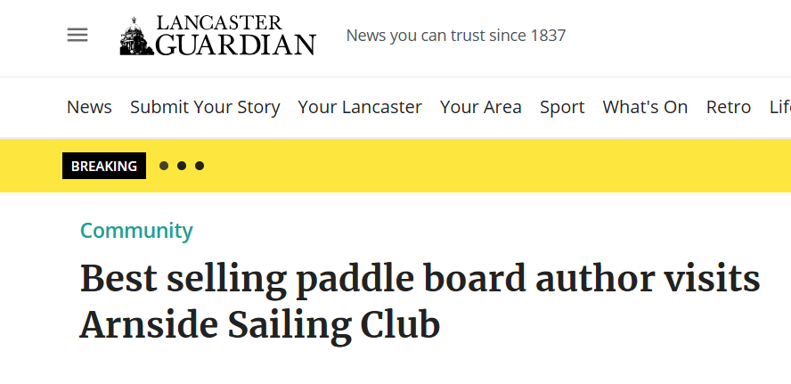
Promoting benefits of belonging to a SUP Club
Social
Safety
Support
Visiting new places
Chance to progress skills

Slide 12
Youth
Regular Junior Sessions
Eg Winsford Flash, Pennine SC
Greater chance to practise
Parents more likely to join
More likely to attract local children, who may be away during school holidays
Lower cost per session to parents
Long term parent involvement / volunteering
Club Nights
Home Ed Sessions
Holiday Programme eg Ullswater Youth Sailing Week
Meets need for children’s holiday activity
Attracts children from outside area
Children learn over a shorter time
Been profitable for club
Less opportunity to practise, make long term friends
Fewer children from Arnside
Less continuity
Greater cost per course to parents eg £175
Bad weather more of a problem
Holiday Sailing Courses
Income from Youth Parents £2150

Slide 13
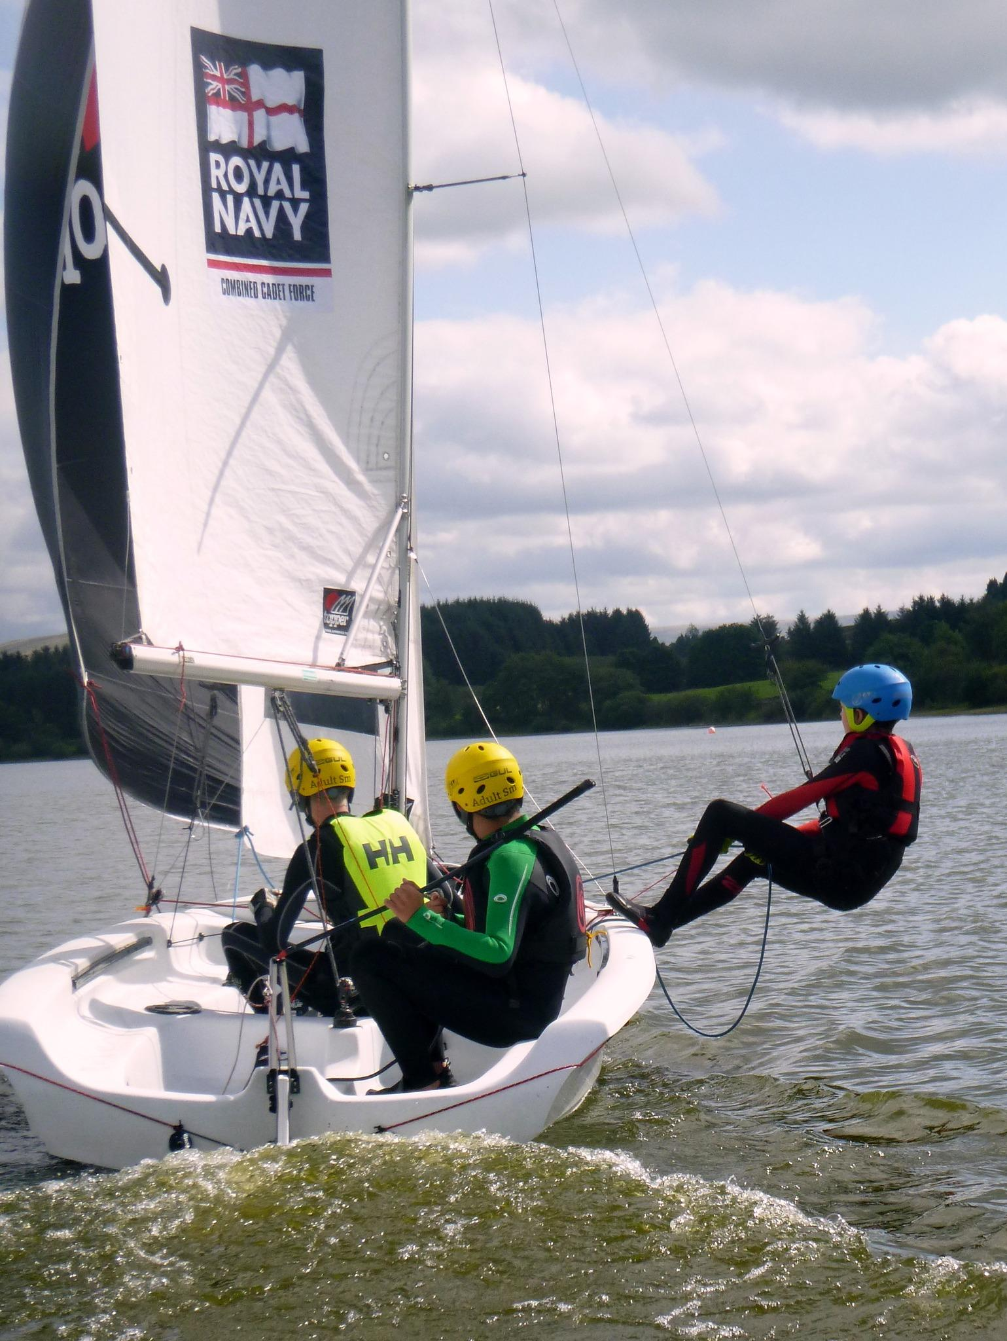
Retaining interest of Older Youth
Advanced Skills
Assistant Instructor Scheme
Youth Racing
Coaching – done by volunteer
Youth Race Training
Take part in club races
Open Events – Southport Race, Lord Birkett
Annual Dinghy Cruise on Lake
Home Ed
8 Improvers, 6 Beginners
What Next?
Boat Building Project

Slide 14
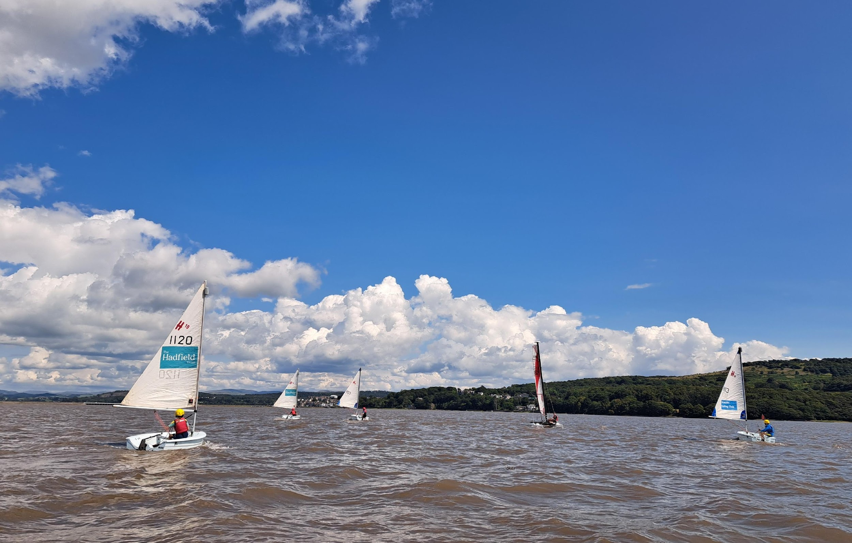
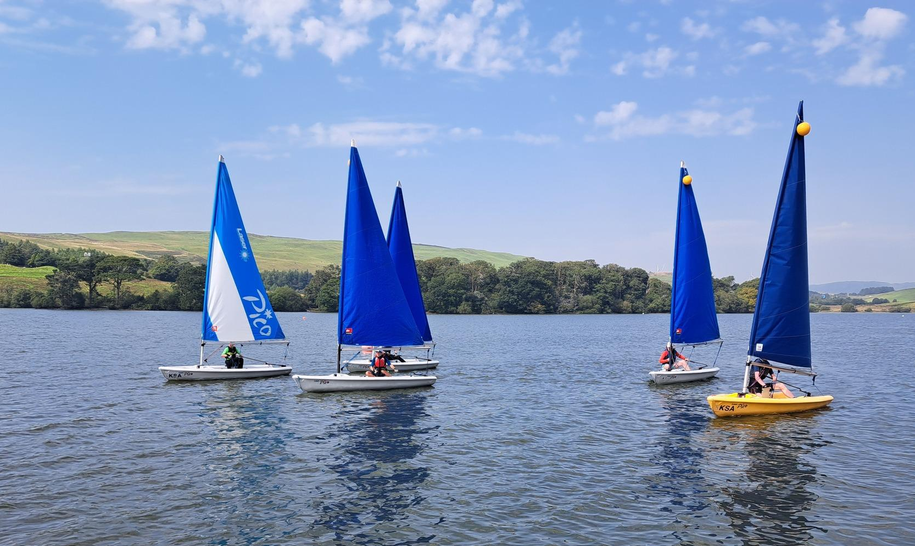
Youth Programme 2026
Taster Sessions Arnside
Holidays Courses at Killington
Follow Up Sessions in holidays
Youth Start Racing Session
Regular Improver Sessions at Arnside
Killington Club Nights
Coniston Dinghy Cruise
Enter Team in Southport 12 hour Race
Youth Volunteer Instructor Programme
Home Ed Programme

Slide 15
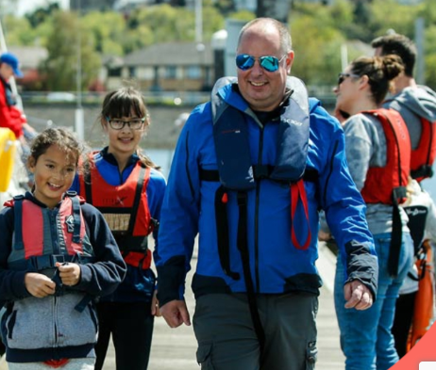
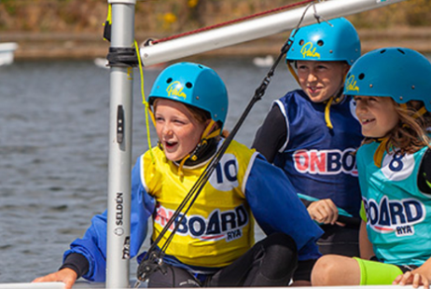
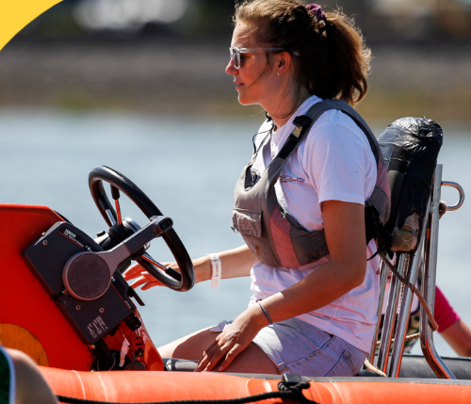
Building up Youth / Parent Community
Start of Season
Meeting / Social Event
Encourage Parents to Support Children
Helping with launching, boat cleaning
Volunteering Opportunities eg safety boat training
Family Sailing
Becoming Youth Coaches
Youth Coordinator

Slide 16
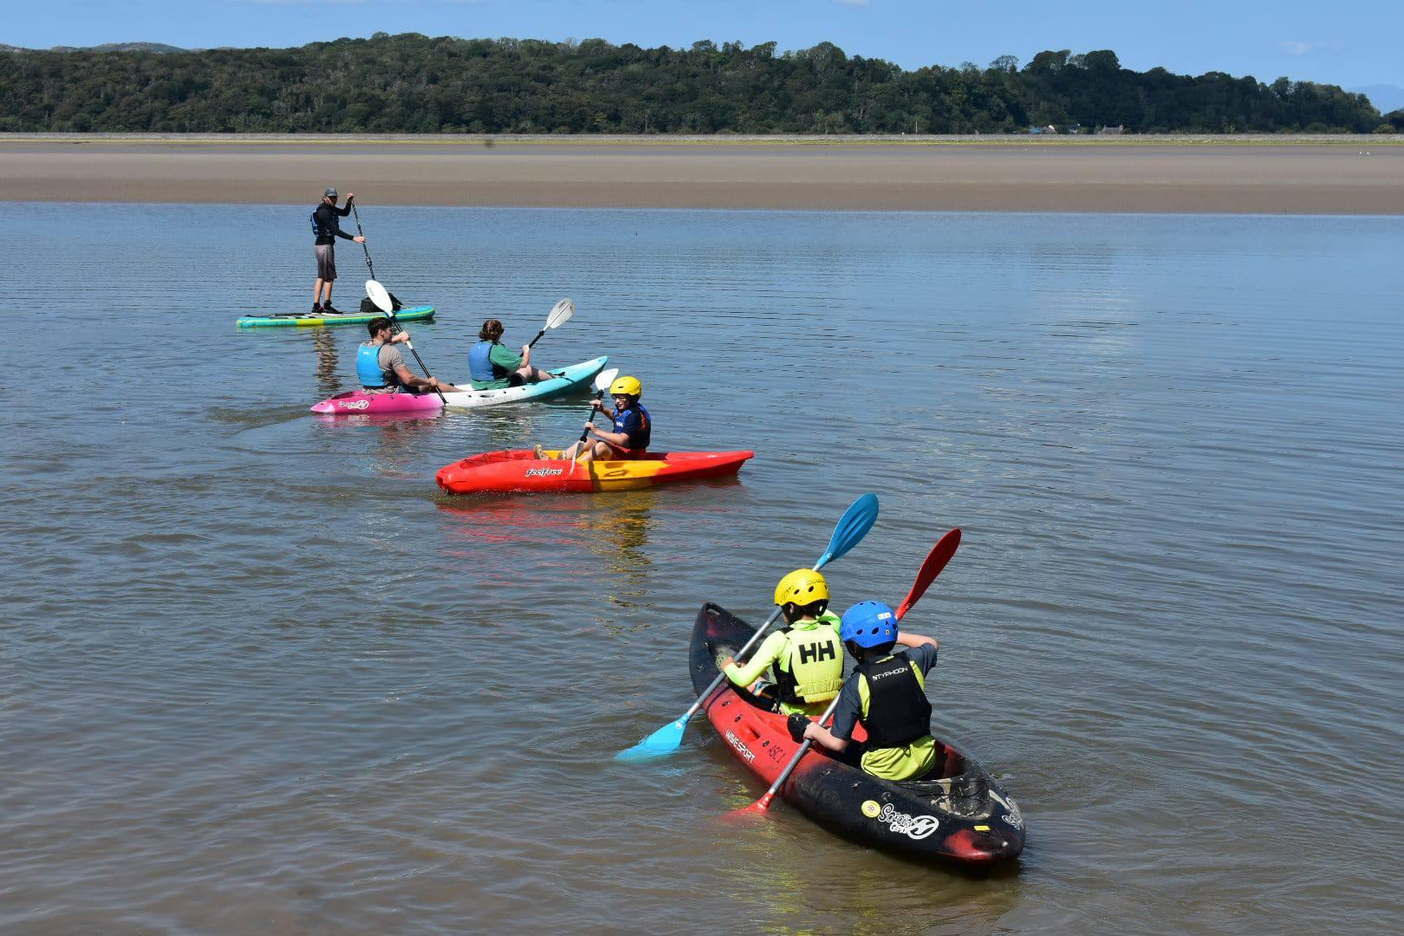
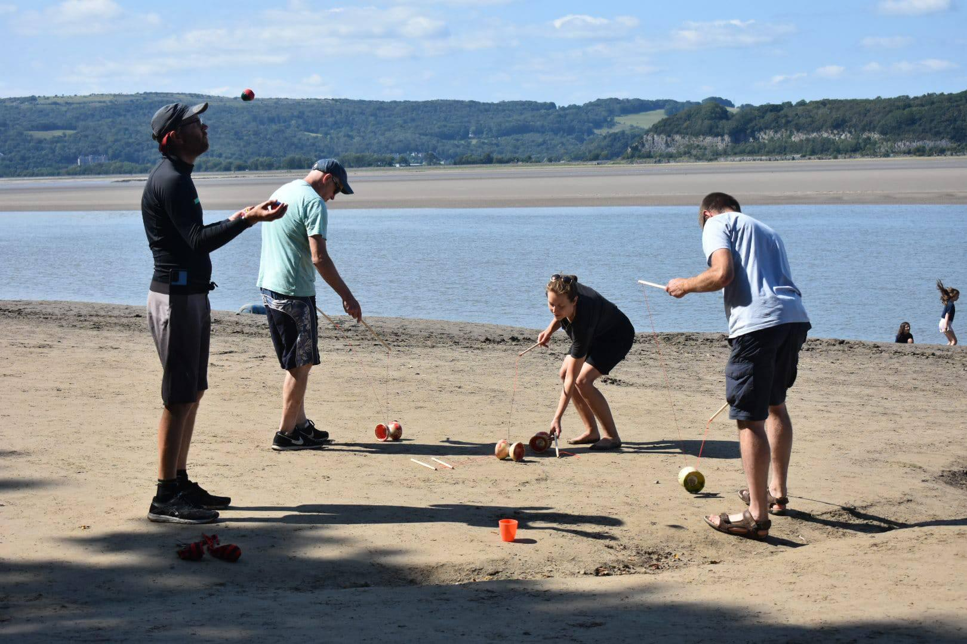
Youth Paddle Sport
Family Taster Days, Beach Activities, Summer Holiday Youth Sessions

Slide 17
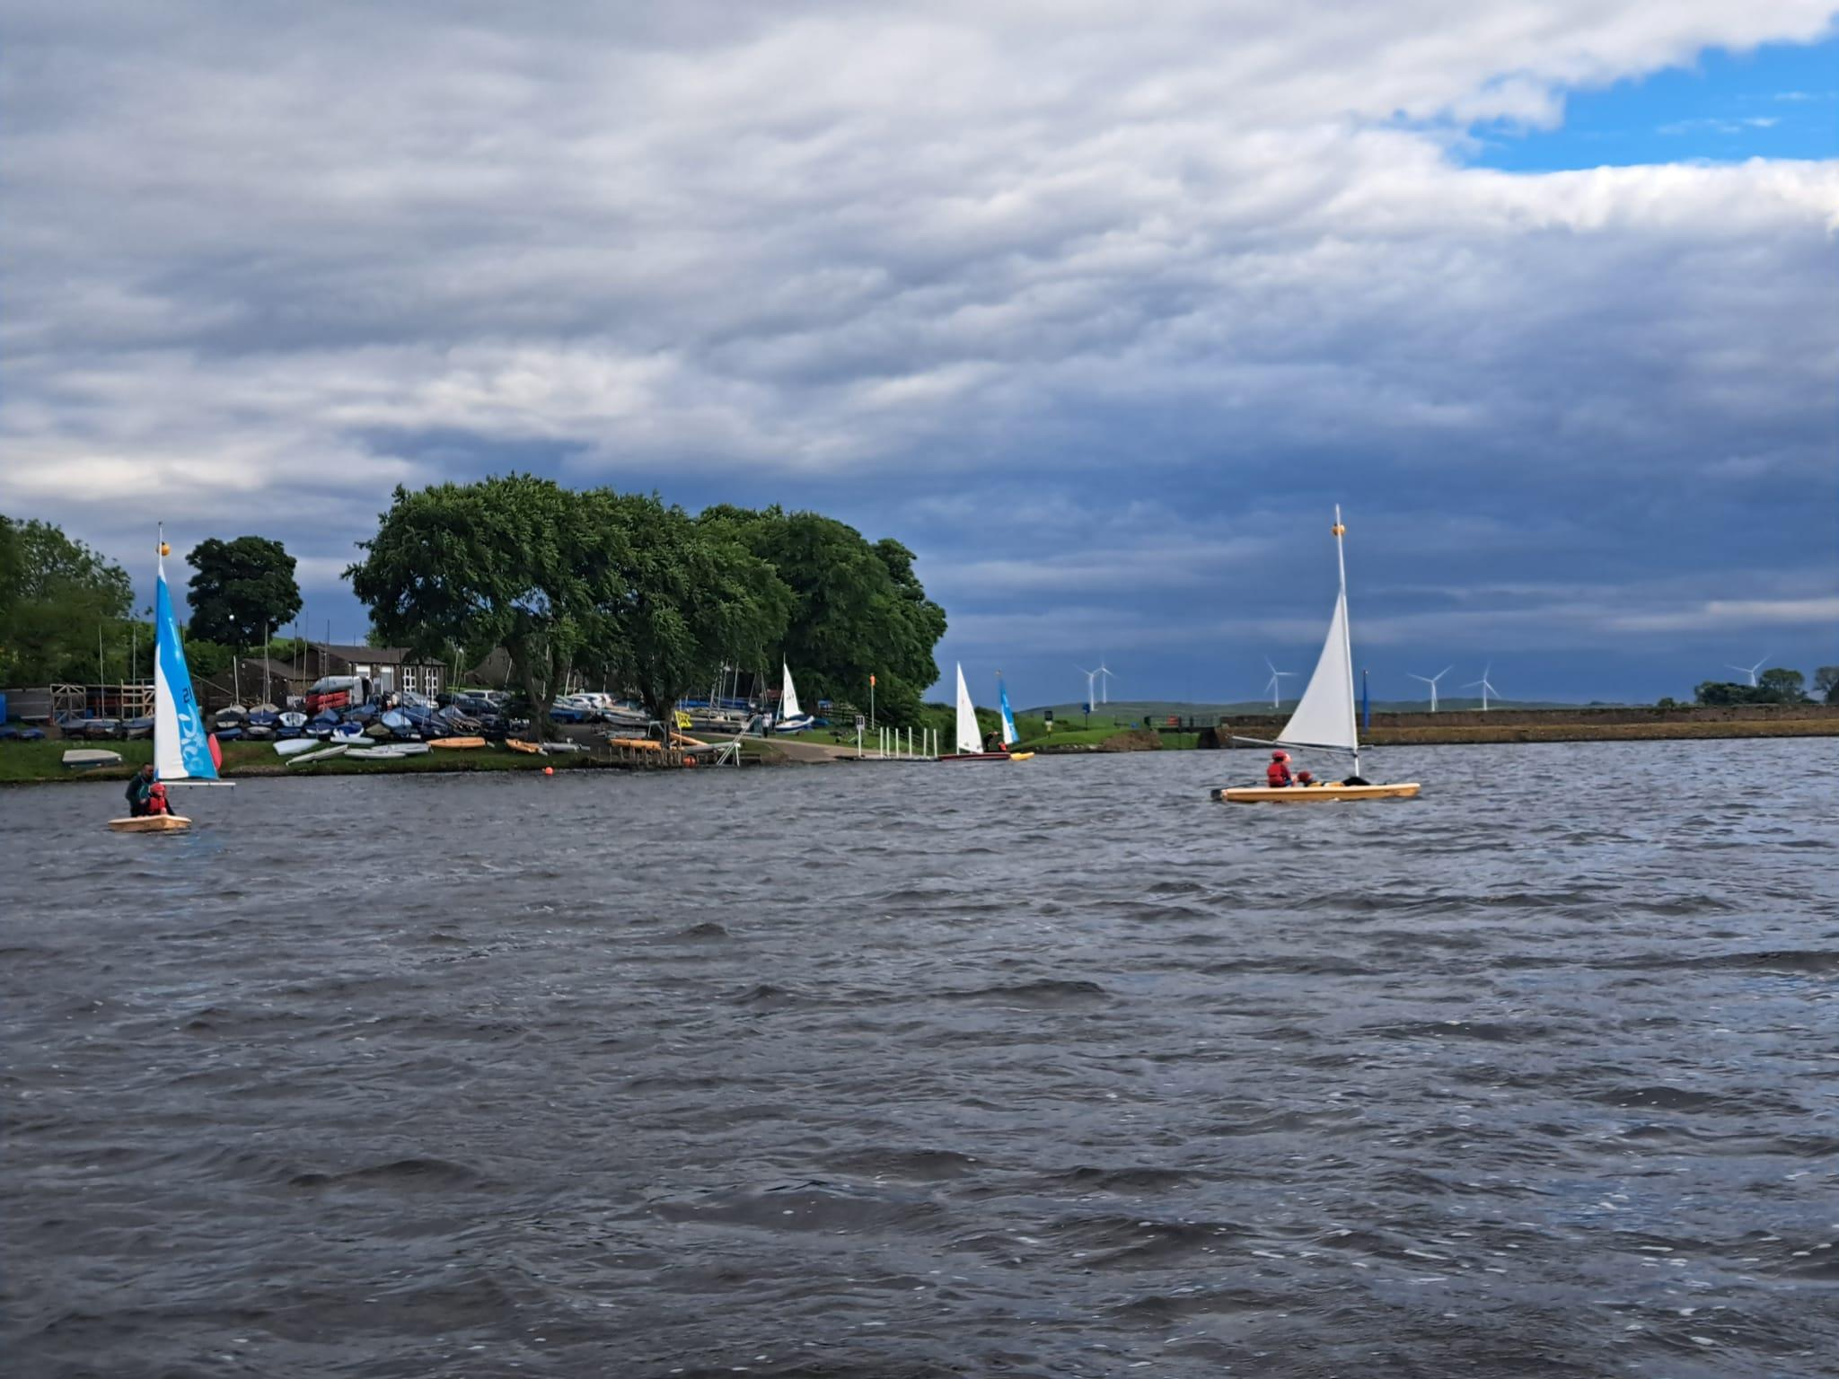
Killington Club Nights
2026 Start of May to mid September
Club Night Prices
Child £4
Adult £8
Arnside Youth Sessions
Members children £10
People booking for both slots
Long way to travel for 1 hour session

Slide 18
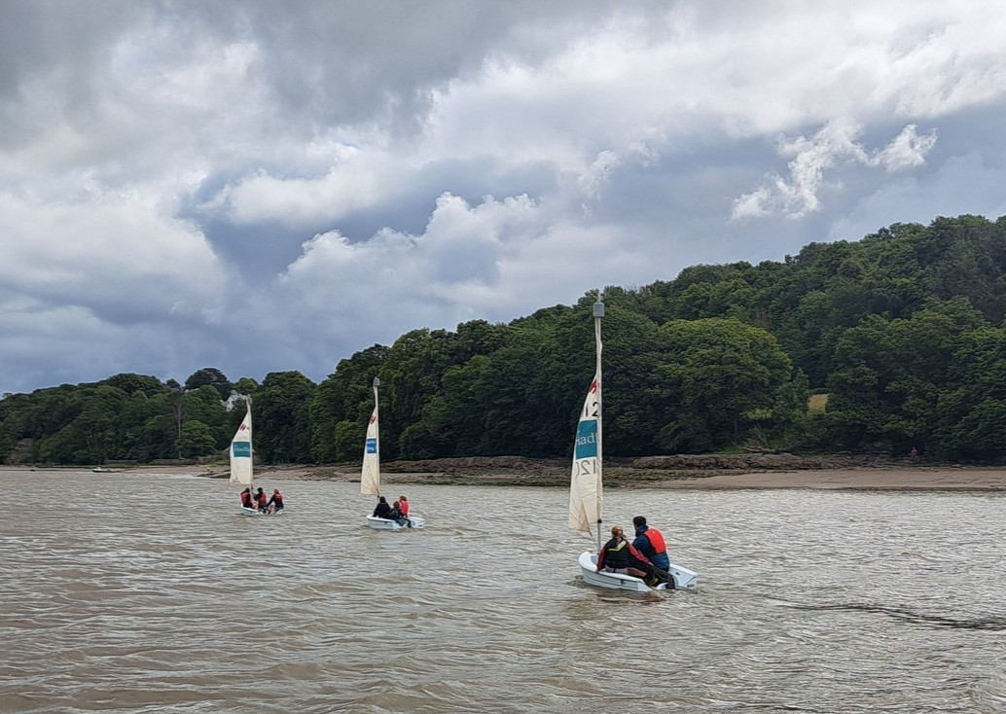
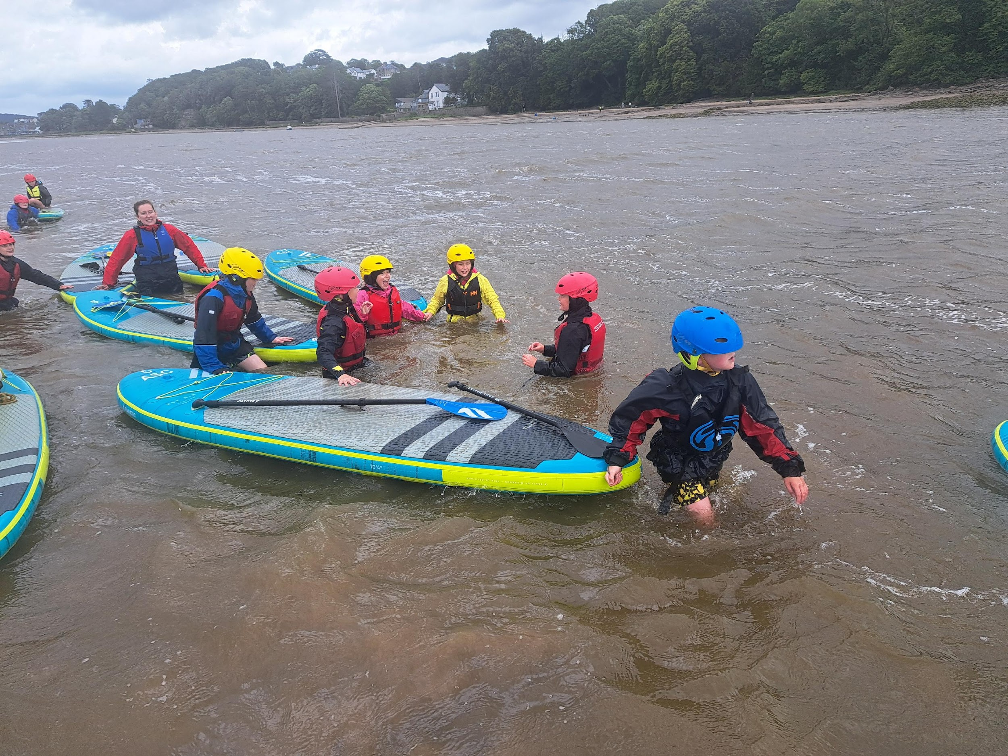
School Groups 2026
Increase number of schools from 3 to 6
Increase youth groups from 3 to 5
Regain Arnside School
Beetham School Weekly RYA 1 Course
Sedbergh Summer School
Paid Instructors supported by Volunteers &Volunteer Instructors
Increase income from £3700 to £6000
Encourage pupils to take part in club activity
£10 voucher
Leaflet to take home to parents
Certificates

Slide 19
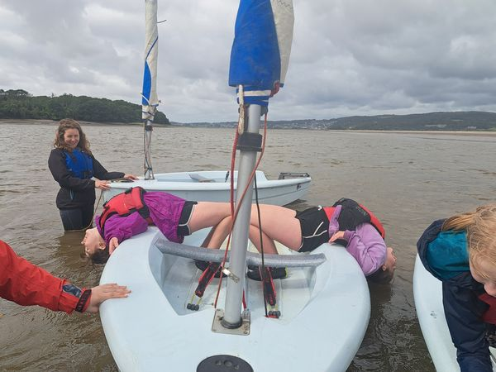
School Groups Future
a) Dependent on professional coordinator to run
b) Desirable to grow programme
charitable aims
source of income
increase membership
c) Future of outdoor education – expand / cut back / opportunities for club
d) AOLA Licence due for renewal in Spring 2028
Long Term Aspiration?
Free RYA 1 Sailing Lessons for 1 to 5 local schools

Slide 20
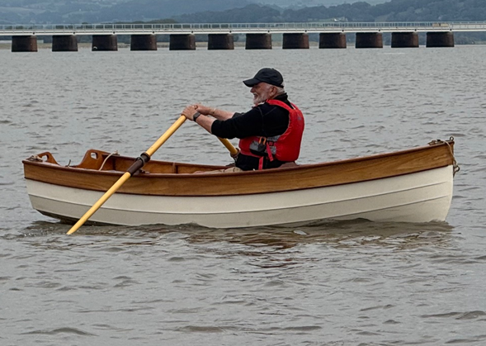
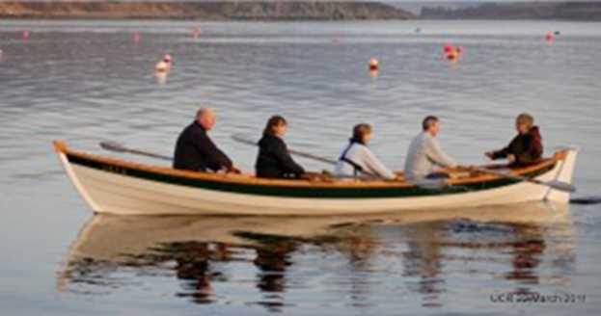
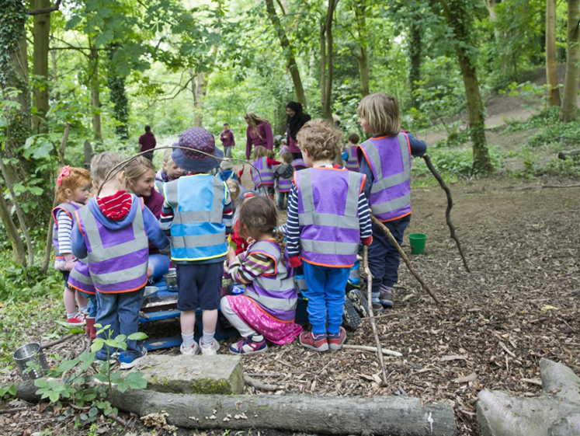
Things to Trial in 2026
Dinghy Rowing
Wing surfing Lessons
Things to look at in Future
Swimming
Forest Schools
Community rowing boat
Sea Kayaking
Colleges / Universities
Work Experience

Slide 21
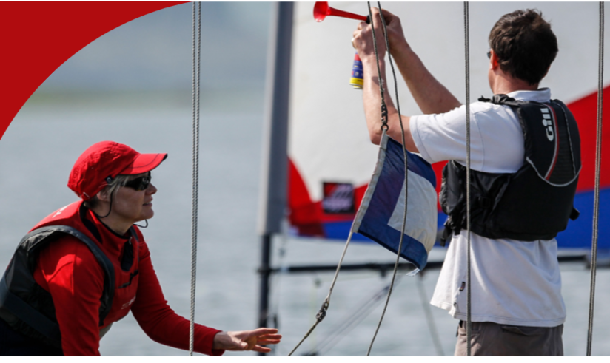
Volunteering
Reasons for not volunteering
a) Time commitments eg Work, Family, Care
b) Other interests
c) Cost in terms of travel, time, paying for training
d) Seen as a chore
e) Not willing to make commitment
f) Poor health
h) Not aware of volunteering opportunities
g) Do not have skills to help
i) Negative experience eg safety boat breaking down, not feeling useful.
i) Contribution not recognised
Nationally Volunteering has declined.
Mirco-volunteering has increased

Slide 22
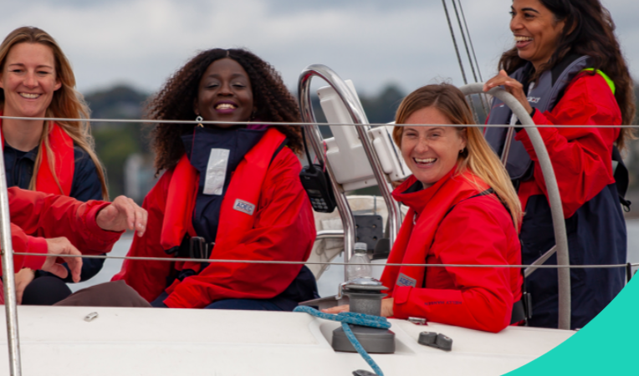
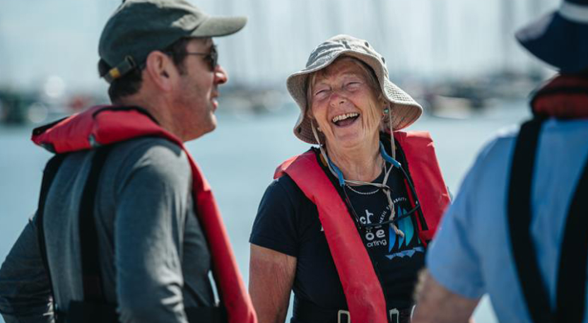
Reasons for Volunteering
Social
Enjoy Task
Sense of purpose
Free time available – retired people
Improve career prospects – young people
Learn new skills
Support Club

Slide 23
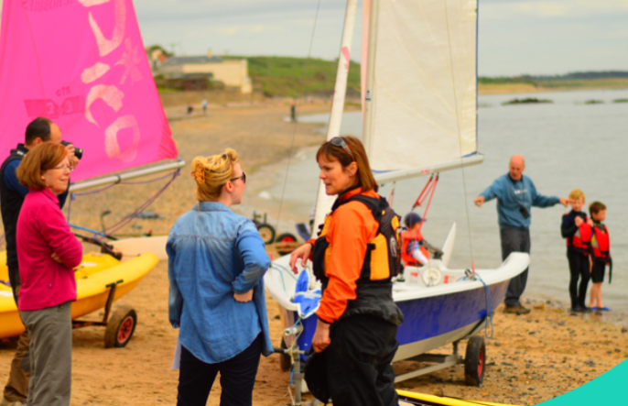
Recruiting New Volunteers
Identifying where volunteers are needed
Identifying Tasks
What roles are needed
Splitting jobs to make workload manageable
What skills, experience and qualifications needed
Making aware of volunteering opportunities
When joining the club
Website & social media
Advertising to local community
Start Low eg ad hoc help with launching
Training / Support
Face to face at start of job
Courses e.g safety boat, instructor courses
Refresher course
Ongoing support
Possible Volunteers
Members
Teenage members
Parents
Retired members
Local Community
As well as ensuring your volunteers have the right skills, developing your volunteers encourages engagement and retention

Slide 24
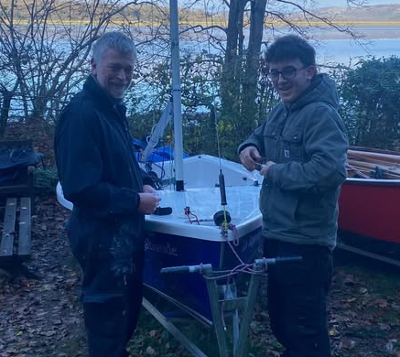
Sailing Club Volunteering
Large amount of volunteering already takes place
Work Parties
Grounds maintenance
Boat maintenance
Helping on shore
Timing Races
Safety Boat
Helping with events
Leading events
Coaching / Instructing
Staffing bar
Clubhouse & Garden maintenance
Committee and Officer Roles
Weaknesses
Making people aware of volunteering opportunities
Supporting / Managing volunteers
Getting people to commit in advance
Limited no of volunteers do most of work
“Easier to do work yourself than get a volunteer to do it”

Slide 25
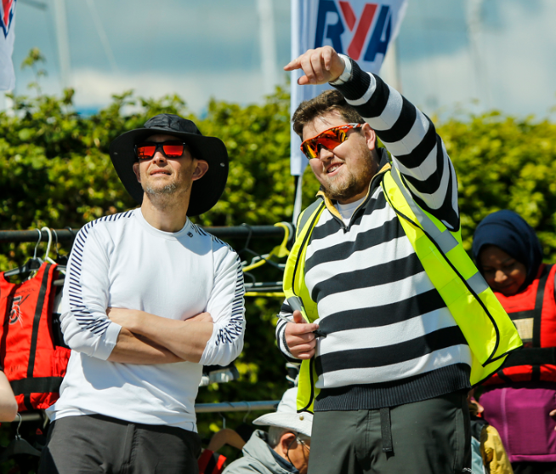
RYA Suggested Volunteer Coordinator Role
Purpose
To facilitate communication between the club and volunteers
Main contact for existing and prospective volunteers
Develop volunteering and volunteer training
Define volunteer roles and ensure that volunteers their role
Provide support to volunteers
Could be combined with secretary or membership secretary role

Slide 26
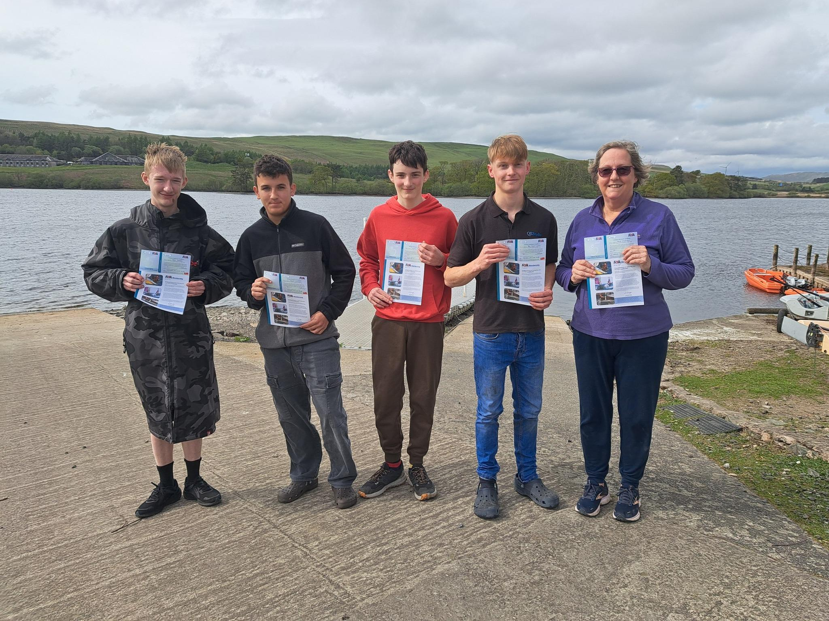
Volunteer Training
2025 Expenditure
Powerboat Refreshers £310
First Aid £285
Safer SUP £300
Assistant Instructor £600
SUP Leader £600
Grants £300
Donations £600
2026
SUP Instructor
Dinghy Instructor
Powerboat Training
First Aid

Slide 27
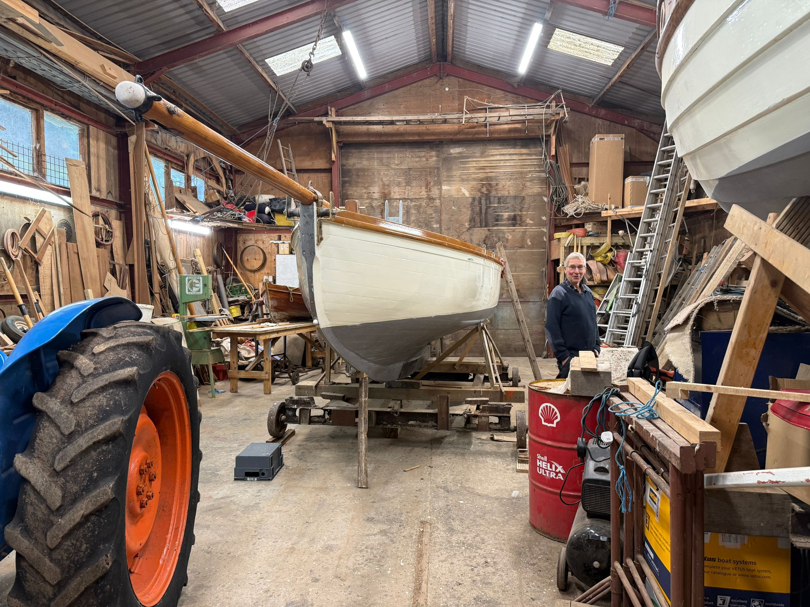
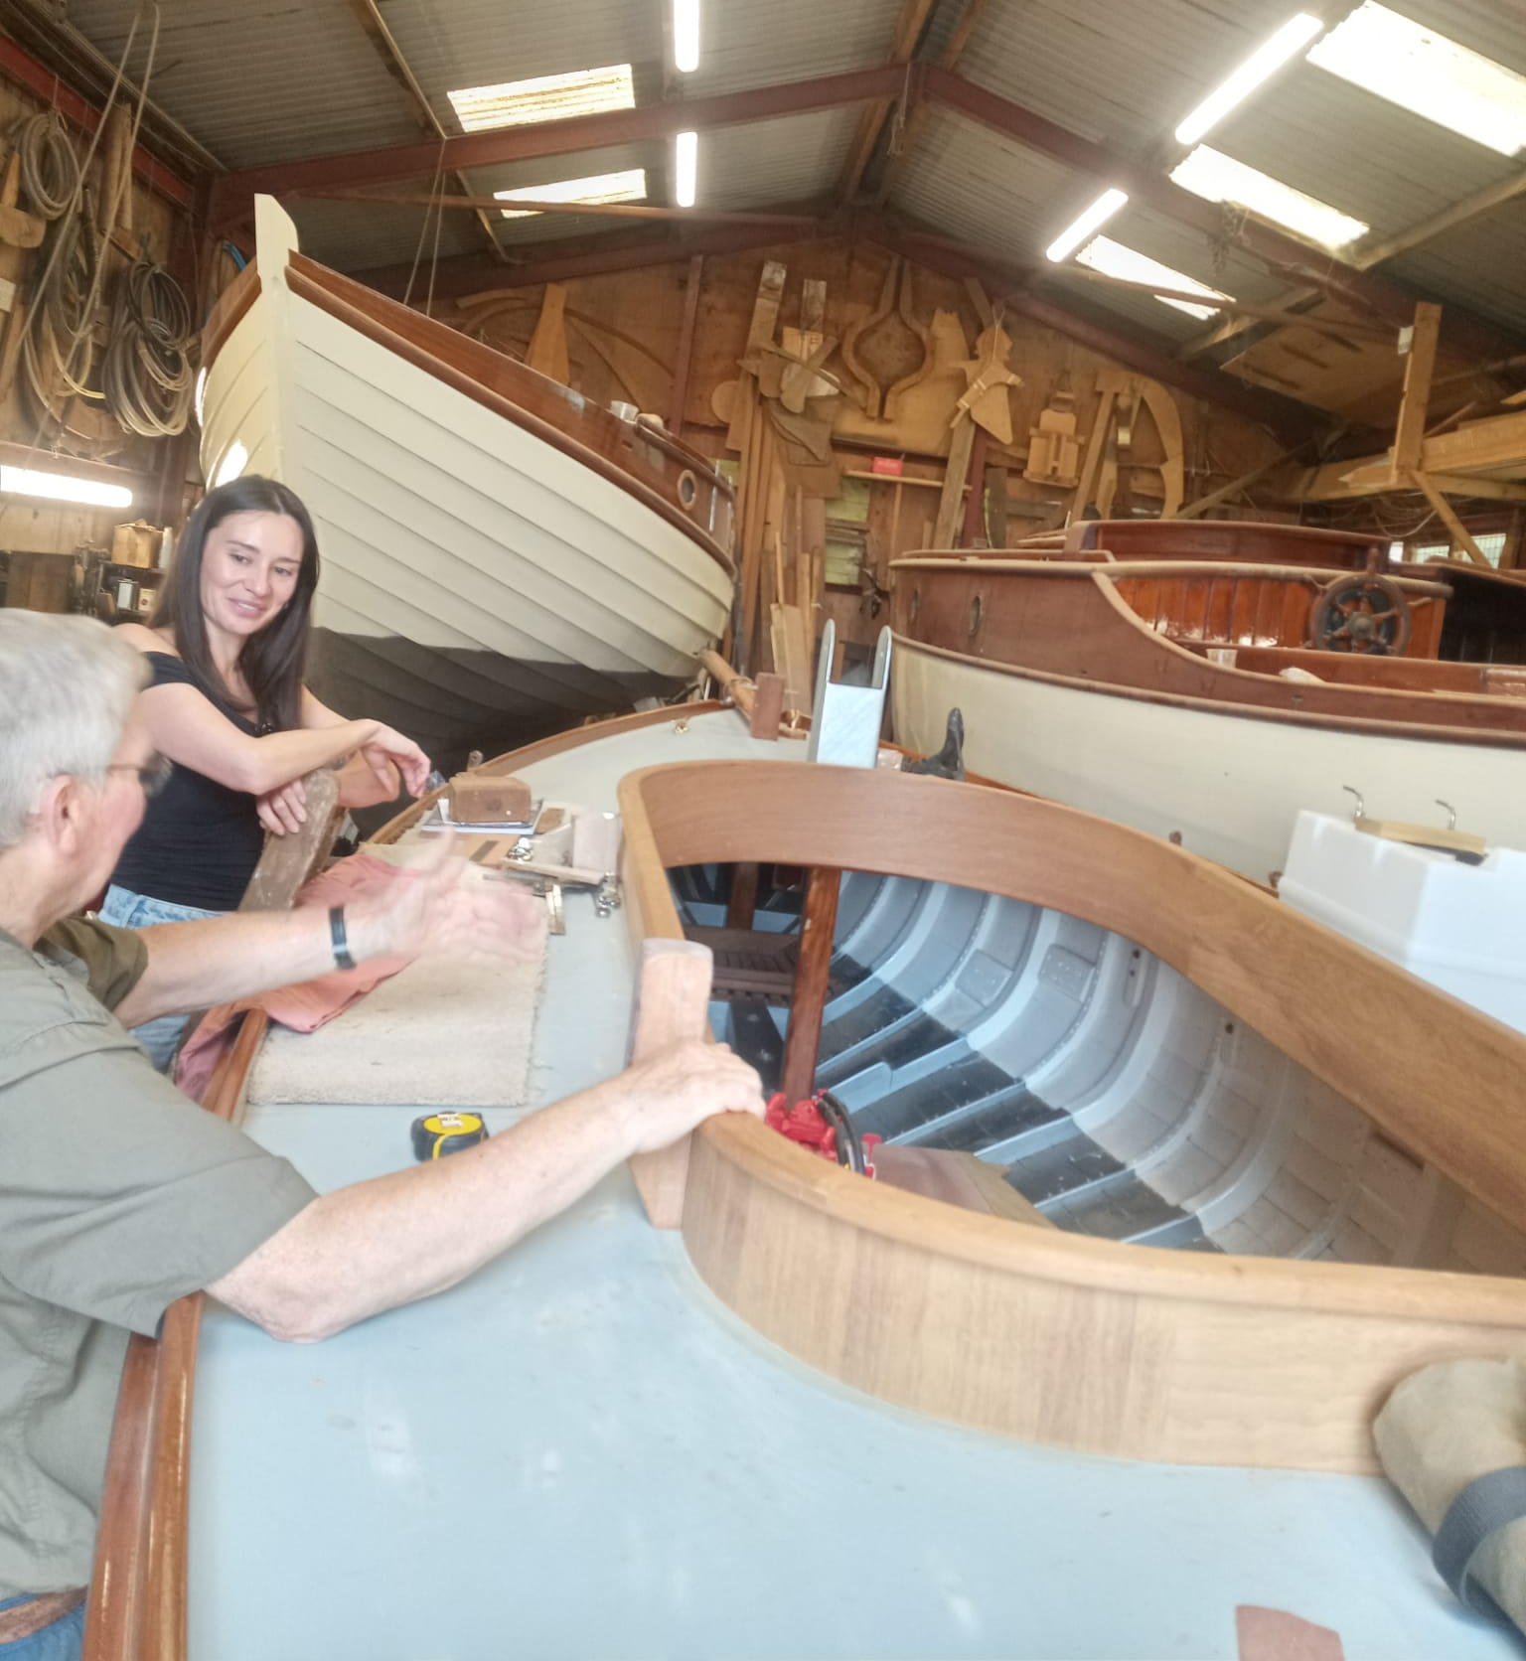
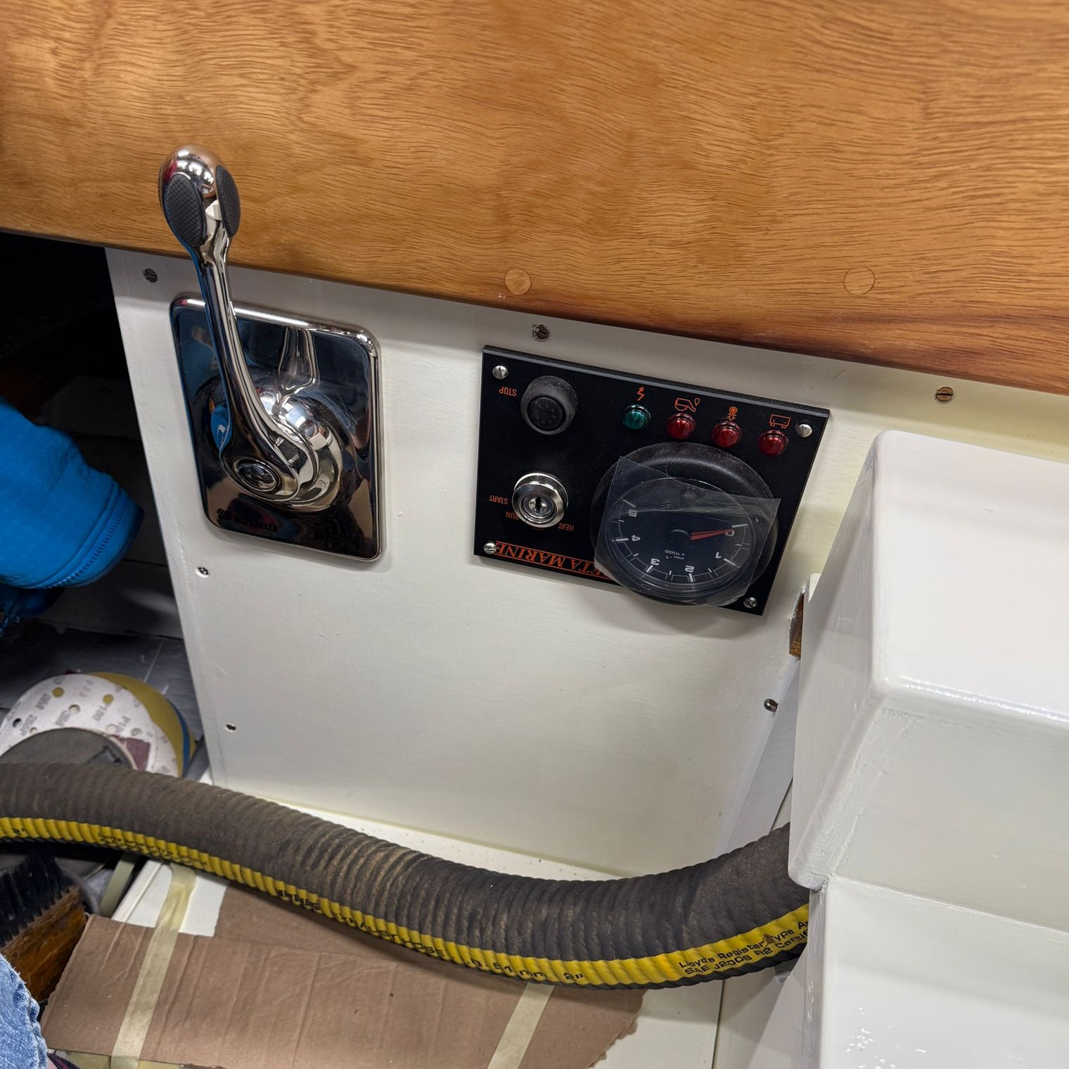
Severn
Severn
R
Take people away from Arnside
May end up being a Roa Island boat rather than Arnside one.
Initial Plans
Sea Trials – Blackpool & Fleetwood Yacht Club
(Joint Event)
Sail to Roa Island
Get use to sailing her at Roa Island
Bring her to Arnside – Celebration
Keep her at Roa Island in winter
Restoration likely to be complete early 2026
23 foot long, draft 3 foot
Running Costs
Insurance, Roa Island Fees,
£800 plus pa

Slide 28
Clubhouse Meeting 19th Nov
Agenda
Music Coordinator
Future music booking
Bar staff and training
Building Work
Future Roof Repairs
Advertising
Heath and Safety / Fire Safety

Slide 29

Development Plan
Do we want to write a new development plan?
Support Funding Bids?

Slide 30

Committee for Next Year
Vacant – Secretary, Sailing Coordinator
Possible Additional Roles Training Principal
Youth Coordinator
Volunteer Coordinator
Membership Secretary
Web & Social Media Editor
Newsletter Editor
Social Secretary
Max Number of Committee Members is 12
Current Number is 8

Slide 31
Fees for Next Year
Family £90 to £95
Individual £80 to £85
Low Income leave at £25
Boat Park Fees – unchanged?
Under 18 foot £35
Over 18 foot £50
Kayaks £15
Use of Club Boats £20 unchanged
Holiday Membership
£20 for a week?
£50 for summer holidays?
Volunteer time in meeting temporary members, providing safety advice, getting them started
Risk
Fewer parents and adult trainees taking out full membership
People taking out temporary membership to get discount on training courses
Safety risk – inexperienced users.
AGM Sat 24 Jan
Papers to go by Sat 14 Jan

